Slide 1

SMART STUDENT
SEARCH & RANKING SYSTEM
A C-based console project for storing, searching, sorting,
ranking and comparing student records.
C + STRUCTURES
4 SEARCH ALGORITHMS
8 SORTING ALGORITHMS
REAL COMPARISON
Members PRN
Vedant Puri 1262252793
Manav Nalkande 1262252526
Bhumil Kiyada 1262253311
Sanskar Thitame 1262252947
Soham Nalawade 1262252642

Slide 2
PROBLEM
02
Problem Statement & Objective
A student record system becomes more useful when search, sorting and ranking can be tested on the same real dataset.
The problem
Our objective
A student record system should store IDs, names, branches, semesters and marks, then quickly find students, organize records and generate ranks. The project also needs to show how much work each algorithm performs instead of relying only on theory.
Build one console program in C that lets the user add and display records, search by ID, sort by different fields, generate rankings and compare algorithms using actual operation counts and measured time.
Core questions the system answers
• Can the same student data be searched using four different methods?
• How do eight sorting algorithms behave on the same records?
• How can equal marks receive the same rank?
• What do real comparison and swap counts tell us about performance?
Smart Student Search & Ranking System

Slide 3
SYSTEM
03
How the System Works
A simple array-based pipeline keeps the original data safe while algorithms operate on the records.
1
2
3
4
5
6
INPUT
STORAGE
SEARCH
SORT
RANK
COMPARE
Add student records
ID • Name • Branch • Semester • Marks
Fixed array of
struct Student
Capacity: 100
Linear • Sentinel
Binary • Fibonacci
Bubble • Selection • Insertion • Shell
Merge • Quick • Radix • Bucket
Merge sort by marks
Equal marks share rank
Comparisons • Swaps
clock() execution time
Important design choice
Binary and Fibonacci search use a sorted copy, so the user's original insertion order remains unchanged.
Smart Student Search & Ranking System

Slide 4
IMPLEMENTATION
04
Data Structures, Files & Tools
The project demonstrates modular programming without advanced data structures.
Data structure
Helper arrays
Tools
struct Student
Fixed-size array of up to 100 records
+ counter for the number of used records
Merge-sort temporary array
Radix output array
2D bucket array
No linked lists, trees, heaps or hash tables
C • GCC (MinGW) • VS Code
Git • GitHub
Console-based application
Five-source modular structure
main
student
searching
sorting
analysis
Menu & program flow
Record input / display
4 search methods
8 sorting methods
Counts & timing
Concepts demonstrated: structures • arrays • modular programming • Big-O • operation counting
Smart Student Search & Ranking System

Slide 5
SEARCHING
05
Four Searching Algorithms
All four methods search for a student ID; binary and Fibonacci search require sorted data.
Algorithm | Main idea | Data requirement | Typical complexity
Linear | Check records one by one | Any order | O(n)
Sentinel | Linear search with a sentinel | Any order | O(n)
Binary | Repeatedly halve the search range | Sorted IDs | O(log n)
Fibonacci | Use Fibonacci-sized search intervals | Sorted IDs | O(log n)
Observed example
Why sorted copy?
ID 103 was found with Binary Search in 1 comparison, while Linear Search needed 3 comparisons in the shown run.
Sorting the working copy enables Binary/Fibonacci Search without changing the original order in which students were entered.
Smart Student Search & Ranking System

Slide 6
SORTING
06
Eight Sorting Algorithms
The same comparison function controls the desired order, so each sorting algorithm is implemented once.
Group | Algorithms | Typical idea / complexity
Simple | Bubble • Selection • Insertion | Easy to understand • O(n²)
Improved | Shell | Gap-based insertion • depends on gaps
Divide & conquer | Merge • Quick | O(n log n) typical efficient performance
Non-comparison | Radix • Bucket | Use digits / value ranges rather than pairwise comparisons
Project comparison on 100 records
Bubble
≈ 5,000 comparisons
Selection
≈ 5,000 comparisons
Merge
≈ 575 comparisons
Quick
≈ 600 comparisons
Radix sort: 0 comparisons because it sorts by digits.
Smart Student Search & Ranking System

Slide 7
RANKING & ANALYSIS
07
Ranking Logic & Real Performance
Ranking uses merge sort by marks, then a single pass assigns ranks with ties handled correctly.
Ranking rule
Performance measurement
1. Sort marks from highest to lowest.
2. First student gets rank 1.
3. Equal marks share the same rank.
4. The next rank is skipped after a tie.
Example: 95, 92, 92, 85 → 1, 2, 2, 4
Counters inside the algorithms record comparisons and swaps during real runs. The C clock() function measures execution time. Values are produced by the program—not hard-coded.
4
8
100
0
search algorithms
sorting algorithms
maximum records
Radix comparisons
The value of the project is not only the result—it is seeing the algorithms work on the same dataset.
Smart Student Search & Ranking System

Slide 8
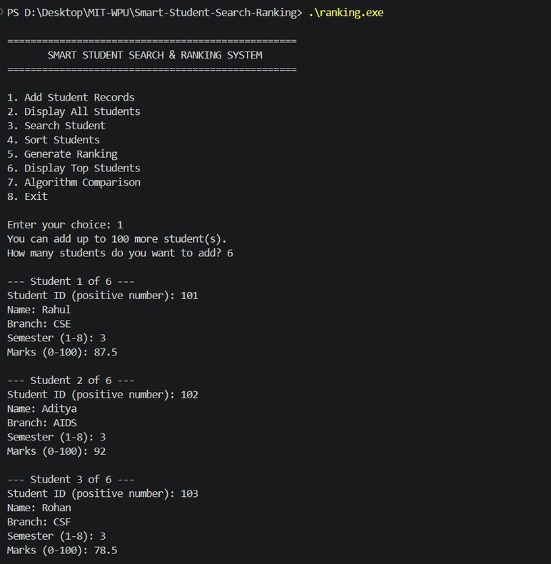
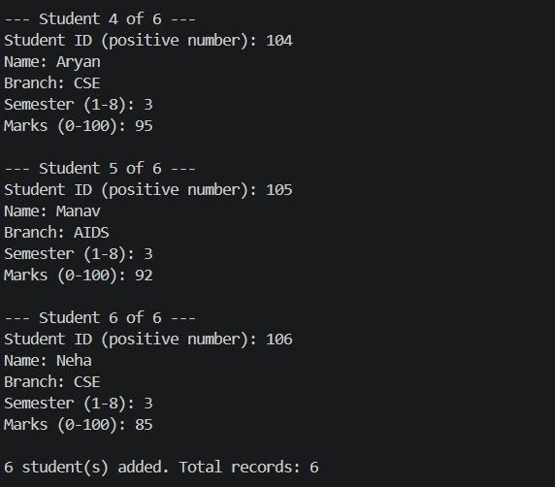
PROGRAM INPUT
08
Input: Adding Student Records
The screenshots show the actual console input used to create the six-record dataset.
STUDENTS 1–3
STUDENTS 4–6
Six records added • IDs 101–106 • Semester 3 • Marks entered by user
Smart Student Search & Ranking System

Slide 9
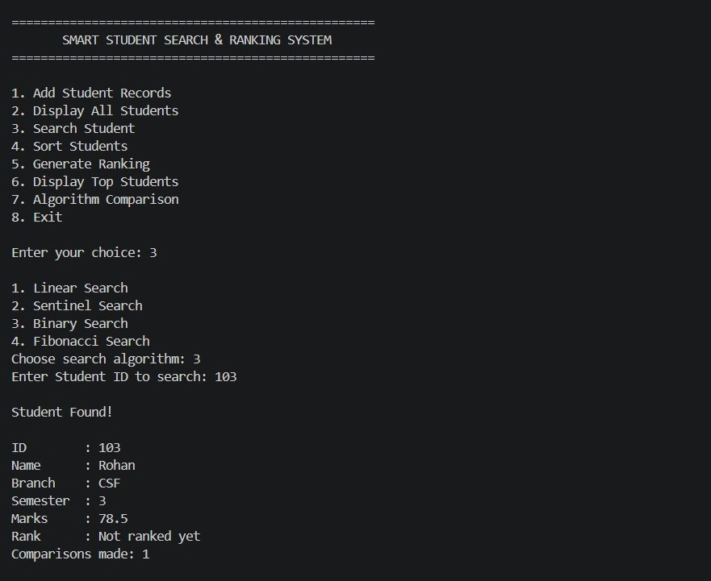
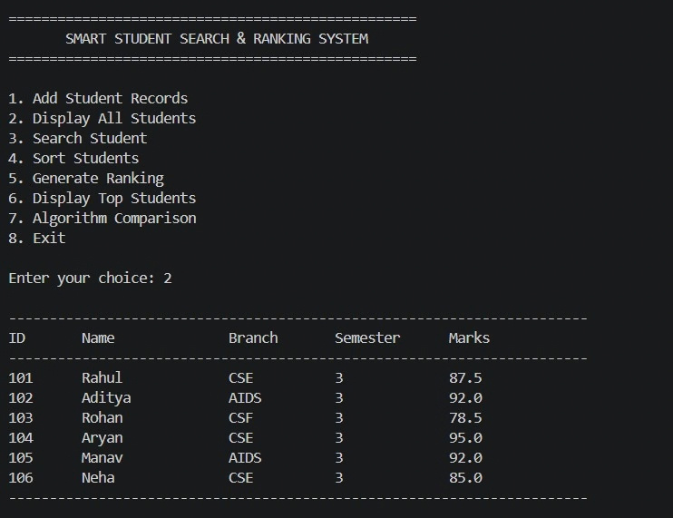
PROGRAM OUTPUT
09
Output: Display & Search
The program can display all records and then search for a specific student using the selected algorithm.
DISPLAY ALL STUDENTS
BINARY SEARCH RESULT
Example: ID 103 → Rohan → CSF → 78.5 marks → found in 1 comparison
Smart Student Search & Ranking System

Slide 10
DATA EXPLANATION
11
What Does Our Input Data Actually Mean?
The six records shown in the program are not just sample output—they are the dataset used by the algorithms.
ID | Name | Branch | Sem. | Marks | Interpretation
101 | Rahul | CSE | 3 | 87.5 | High score
102 | Aditya | AIDS | 3 | 92.0 | Joint high score
103 | Rohan | CSF | 3 | 78.5 | Lowest in sample
104 | Aryan | CSE | 3 | 95.0 | Highest score
105 | Manav | AIDS | 3 | 92.0 | Tie with ID 102
106 | Neha | CSE | 3 | 85.0 | Middle score
Dataset size
Important tie
Why this matters
6 records are currently entered; the program can store up to 100.
Aditya and Manav both have 92.0 marks.
The tie is used to demonstrate rank handling.
Smart Student Search & Ranking System

Slide 11
DATA EXPLANATION
12
How to Read the Algorithm Results
The numbers help us connect Big-O complexity with the amount of work observed during actual runs.
Operation | Observed / stated result | What it tells us
Linear Search | ID 103 → 3 comparisons | Checks records sequentially
Binary Search | ID 103 → 1 comparison | Can eliminate half the range each step
Bubble Sort | ≈ 5,000 comparisons / 100 records | Quadratic growth becomes expensive
Selection Sort | ≈ 5,000 comparisons / 100 records | Also performs many pairwise checks
Merge Sort | ≈ 550–600 comparisons | Scales much better for larger n
Quick Sort | ≈ 550–600 comparisons | Efficient typical behaviour
Radix Sort | 0 comparisons | Orders by digits rather than comparing pairs
Key idea:
Big-O gives the expected growth pattern; operation counters show what actually happened on this dataset.
Smart Student Search & Ranking System

Slide 12
CONCLUSION
10
Key Results, Limitations & Takeaway
A compact project that connects classroom algorithms to measurable program behaviour.
Key results
Limitations
What we demonstrated
• Bubble & Selection: ≈ 5,000 comparisons for 100 records
• Merge & Quick: ≈ 550–600 comparisons
• Binary search example: 1 comparison
• Linear search example: 3 comparisons
• Radix: 0 comparisons
• Capacity is fixed at 100 students
• Records are lost when the program exits
• Search is by ID only
• Console interface only
• Structures & arrays
• Big-O thinking
• 4 searching methods
• 8 sorting methods
• Ranking with ties
• Real operation counts & timing
• Modular C programming
ONE-LINE SUMMARY
“We built a student record system in C using only arrays and structures, and used it to implement, test and compare 4 searching and 8 sorting algorithms with actual measured results.”
Thank you
Smart Student Search & Ranking System

